Slide 1
An Article By Any Other Name….. The Low-Down on Feature Articles

Slide 2
What is a Feature Article?
Creative
Deals with real events, issues, and trends
Unlike news articles, it places emphasis on the people involved rather than on the facts
Written to a specific audience
Author writes to persuade readers to adopt his opinion on the topic
Organized with text features

Slide 3
The Various Feature Articles
Human Interest
Personality
Process Analysis
How to (Skill or Product)
Persuasive Article
Past Events
Technical/Informative
News Feature

Slide 4
How can I be creative and engage the reader?
Anecdotes
Vignettes
Foreshadowing
Descriptions
Flashbacks
Tables
Comparisons
Sketches
Examples
Charts
Riddles
Snapshots
Pictures
Graphs
Quotes
Reasons/facts

Slide 5
Be Creative with Text
HEADINGS
“Subheadings”
FONTS
Italics
Bold print
Bullets
COLOR ink

Slide 6

The Human-Interest Feature
Most common feature article
Reports success in spite of great odds
Recalls tragic predicament
Shares continuing struggles supported only by hope and fate.

Slide 7
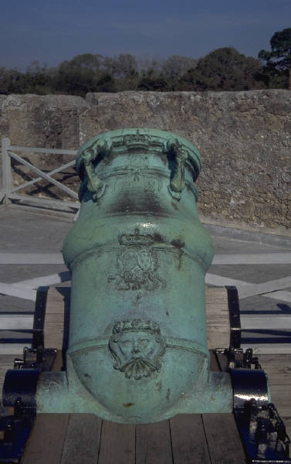
The Past Events Feature
Might focus on a historical event
Might focus on a historical celebration
Stems from library research and serves as a human interest history lesson

Slide 8
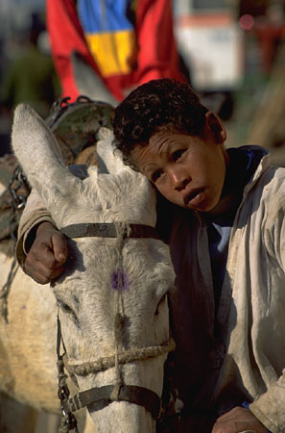
The News Feature
A human interest focus on breaking news
Adds personal involvement to what may otherwise be a distant, unimportant event

Slide 9

The Informational Feature
Insightful coverage of topic
Detailed information focused on one aspect of a given topic
Makes personal connection to the topic and shows “voice”
Often refers to research sources

Slide 10

The Personality Feature
Resembles a characterization
Usually shows how a person gained recognition
The main character may be known or unknown but has done something of interest to others

Slide 11

The How-To Feature
Written from viewpoint of informed writer to less informed reader
Usually takes a do-it-yourself approach
Process analysis article
Gives detailed steps

Slide 12
Features of “The Best” Articles
Personal experience with the product
Proof, along with examples, that this is the best of its kind
Where to get the product
Cost of the product
Catchy title

Slide 13

Identify Topic and Audiences
Choose topic
Why ?
Who would want to read this article?
Who is the primary audience?

Slide 14
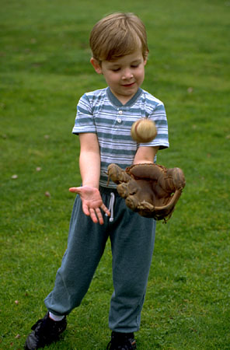
Analyze the Audience
Does the audience know anything about this topic?
What does the audience need to learn after reading the article?

Slide 15
Engage the Reader
Anecdotes
Vignettes
Comparison/contrast
Quotes
Charts/graphs
Snapshots/sketches
Pictures
Descriptions
Facts
Foreshadowing
Flashbacks
These make the article more interesting

Slide 16

Organize the Information
Headlines
Catchy titles
Subheadings
Bullets
Bold print
Various fonts

Slide 17
Word Process
Column format
Spell check
Grammar check
Sources listed at bottom of article

